Slide 1
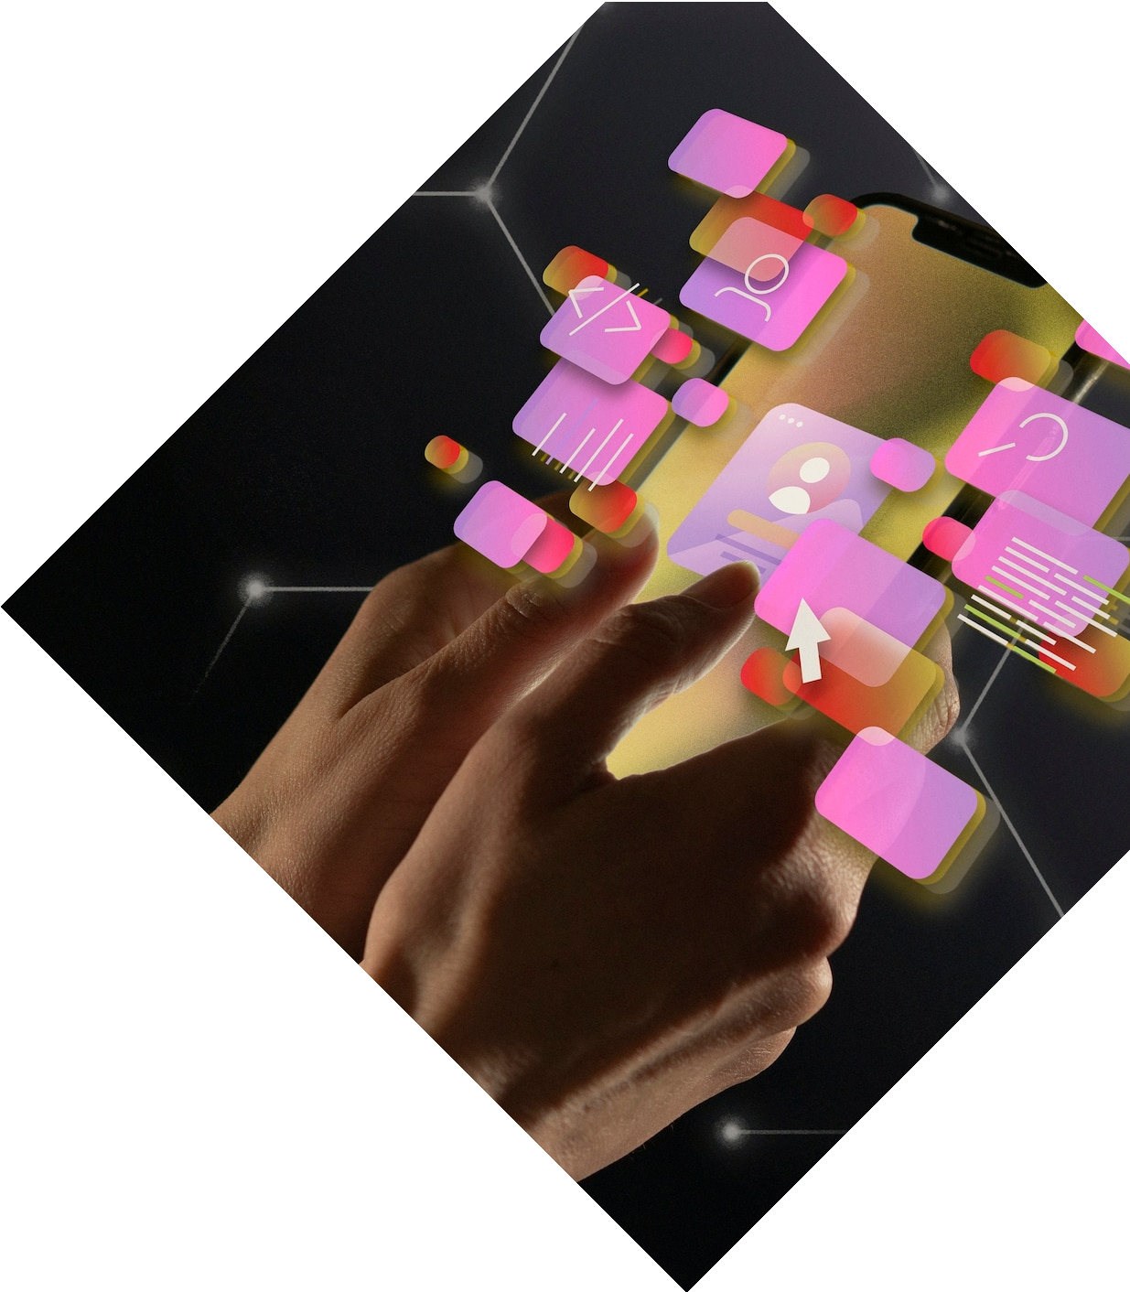
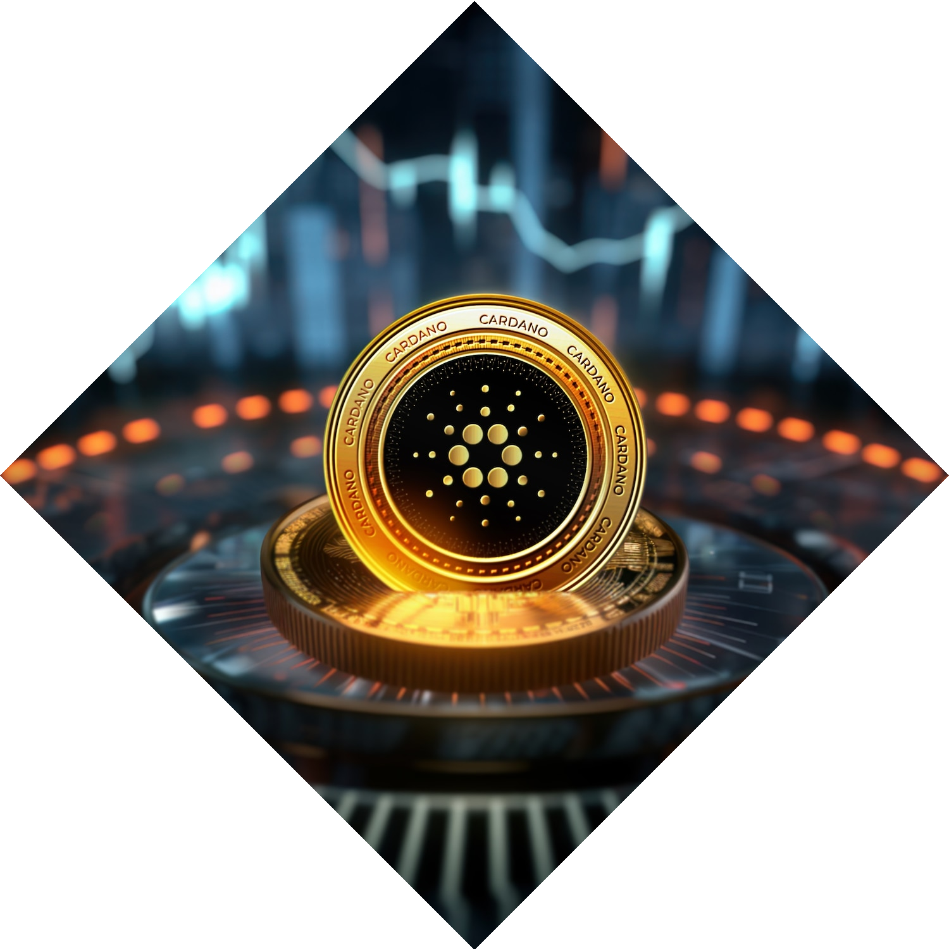
Unlocking the Potential: Unleashing the Power of Real World Asset Tokenisation
Welcome to the world of real world asset tokenisation, where traditional assets are transformed into digital tokens. Explore the innovative possibilities and opportunities that this revolutionary concept brings to the ﬁnancial landscape.

Slide 2


OUR APPROACH
Real-world asset tokenization involves digitizing ownership or shares of assets on a blockchain, enhancing accessibility and market efficiency. The process begins with clearly defining the asset, such as real estate or stocks, ensuring legal compliance. Choosing a suitable blockchain platform, often Ethereum, is crucial. Smart contracts, developed based on standards like ERC-1155 or ERC-721, embody asset ownership rules. Security audits are imperative to address vulnerabilities. The overall aim is to create digital tokens that represent ownership rights in a secure and legally compliant manner.

Slide 3
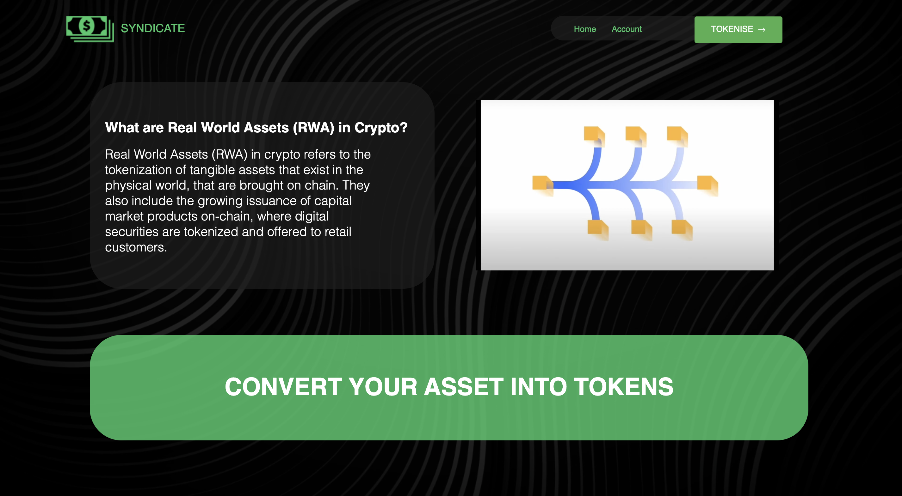

Front end

Slide 4


We offer 3 categories for now

Slide 5
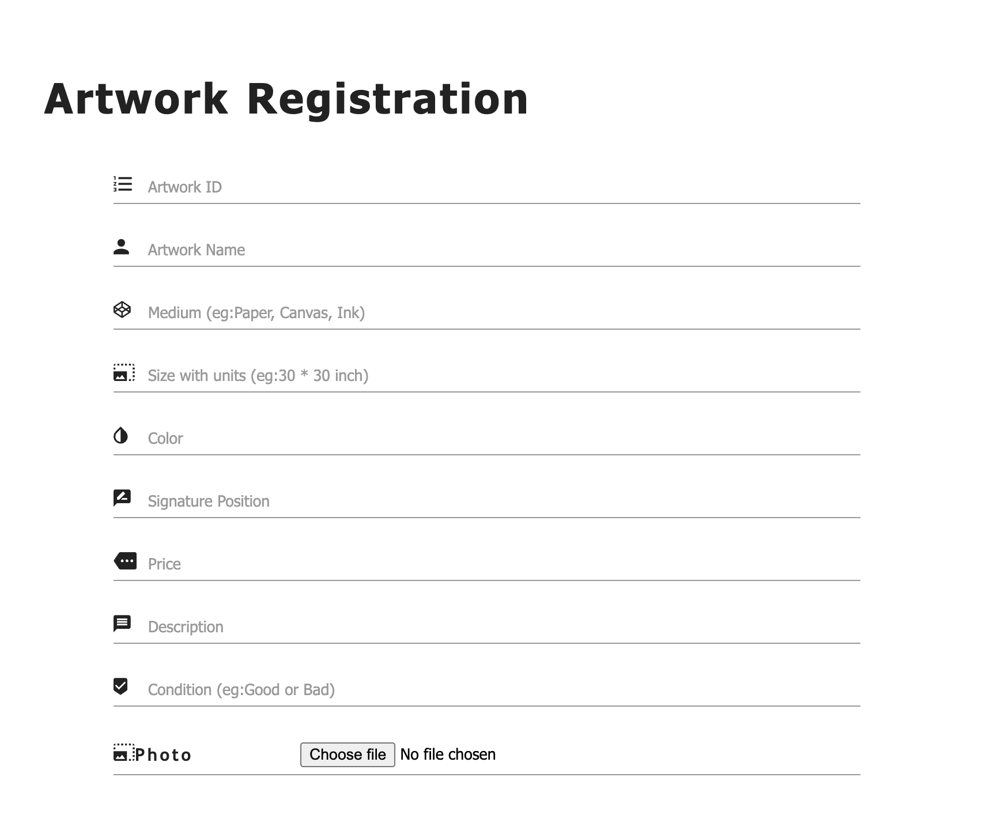
Unleashing Potential
Registrations of assets
Real world asset tokenisation is not just a concept; it's a transformative force reshaping the ﬁnancial world. Embrace the power of digital tokens to revolutionize asset ownership and investment. Let's unlock the potential together!

Slide 6
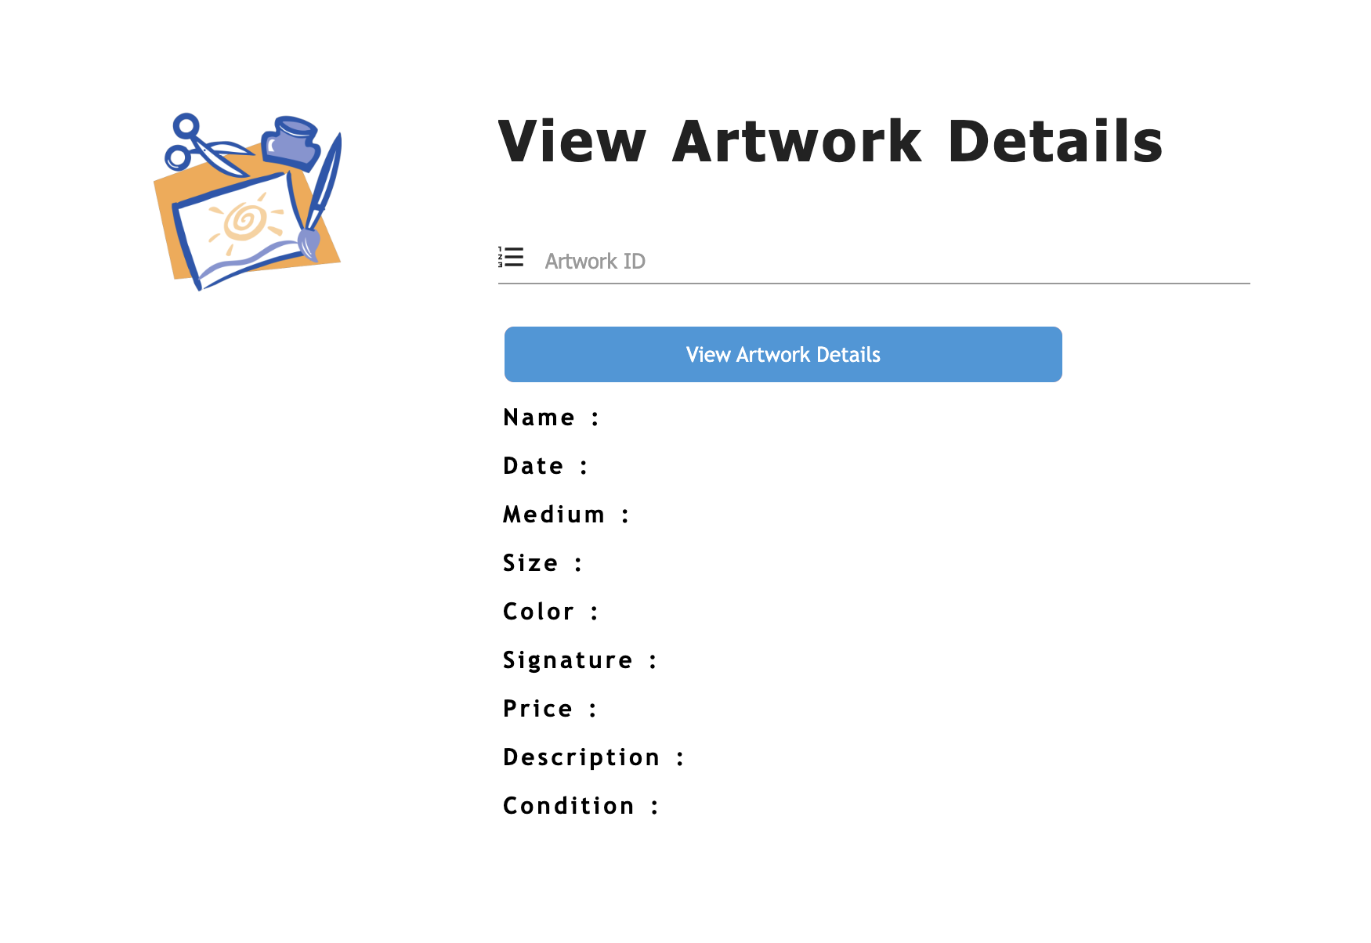
Unleashing Potential
Details of tokens
Real world asset tokenisation is not just a concept; it's a transformative force reshaping the ﬁnancial world. Embrace the power of digital tokens to revolutionize asset ownership and investment. Let's unlock the potential together!

Slide 7
Thanks!
SYNDICATE
Contributors-
Aniket singh, Dev pratap, Arnav singh
Mob-8959888088
Email- its.aniketsingh04@gmail.com

